Slide 1
Face Recognition Attendance Management System using Haarcascade-LBPH
By: Deepika Chindi
Bhavyashree Devadiga

Slide 2
Introduction
To maintain the attendance record with day-to-day activities is a challenging task.
The conventional method of recording each employees name is time consuming and there is always a chance of record being lost sometimes.
This system is based on face recognition to maintain the attendance record of employees.
The daily attendance of employees is recorded and stored. As the in- time for arrivial of employees the system automatically starts taking snaps and then apply face detection and recognition technique to the given image and the recognize employees are marked as present and their attendance update with corresponding time and employee id.

Slide 3
Challenges
Illumination : Illumination stands for light variations
Pose variation: Face Recognition Systems are highly sensitive to pose variations
Occlusion:Occlusion means blockage, and it occurs when one or other parts of the face are blocked and whole face is not available as an input image.
Expressions:Face is one of the most crucial biometrics as its unique features play a crucial role in providing human identity and emotions. Varying situations cause different moods which result in showing various emotions and eventually change in facial expressions
Model Complexity:Existing state-of-the-art facial recognition methods rely on ‘too-deep’ Convolutional Neural Network (CNN) architecture which is very complex and unsuitable for real-time performance on embedded devices.

Slide 4
Objectives
Face Recognition Attendance management system is software developed for maintaining the attendance of the employees on the daily basis in the organization.
We aim to provide user-friendly interface to the organization.
This system will also help in evaluating attendance of employee. Report of the employees attendance on day to day basis is generated.

Slide 5
Problem Definition
To develop an automated attendance system using face recognition concept in a organization with large number of employees, it is a very tedious and time consuming task to record attendance manually. Therefore, we can implement an effective system which will mark the attendance of employees automatically by recognizing their faces.
The process of this face recognition system is divided into various steps, but the important steps are detect the face and recognition the face. Firstly, to mark the attendance of employees , the image of employees faces will be required.
There is a need to develop a real time operating employee attendance system which means the identification process must be done within defined time constraints to prevent omission.
The extracted features from facial images which represent the identity of the employees have to be consistent towards a change in background, illumination, pose and expression.

Slide 6
Machine learning Algorithms used:
1. Face Detection using Haar-Cascade:
It is a machine learning based approach where a cascade function is trained from a lot of positive and negative images (where positive images are those where the object to be detected is present, negative are those where it is not).
It is then used to detect objects in other images.
OpenCV offers pre-trained Haarcascade algorithms, organized into categories (faces, eyes and so forth), depending on the images they have been trained on.
2. Local Binary Pattern Histogram (LBPH):
Local Binary Pattern (LBP) is a simple yet very efficient texture operator which labels the pixels of an image by thresholding the neighborhood of each pixel and considers the result as a binary number.
It has further been determined that when LBP is combined with histograms of oriented gradients (HOG) descriptor, it improves the detection performance considerably on some datasets.
3. K-Nearest Neighbors Algorithm:
The k-nearest neighbors algorithm, also known as KNN or k-NN, is a non-parametric, supervised learning classifier, which uses proximity to make classifications or predictions about the grouping of an individual data point.
While it can be used for either regression or classification problems, it is typically used as a classification algorithm, working off the assumption that similar points can be found near one another

Slide 7
Software and Hardware Requirements
Software Requirements
1.Python
2.OpenCV
3.Numpy
4.Visual Studio
5.HTML
6.Flask
7.Pandas
8.Joblib
Hardware Requirements
1.Processor: Modern multicore processor is required such Intel Core3
2.Memory: 8 GB of RAM is recommended
3.Storage: A solid-state drive (SSD) is recommended for faster data access.
4.Graphics Card: A graphics card with CUDA support can significantly accelerate the LBPH algorithm, especially for large datasets. NVIDIA graphics cards are recommended for CUDA support.
5.Camera: A high-resolution camera with at least 720p resolution is recommended.
6. Other peripherals: The system may require additional peripherals such as a display, keyboard, and mouse for development and testing.

Slide 8
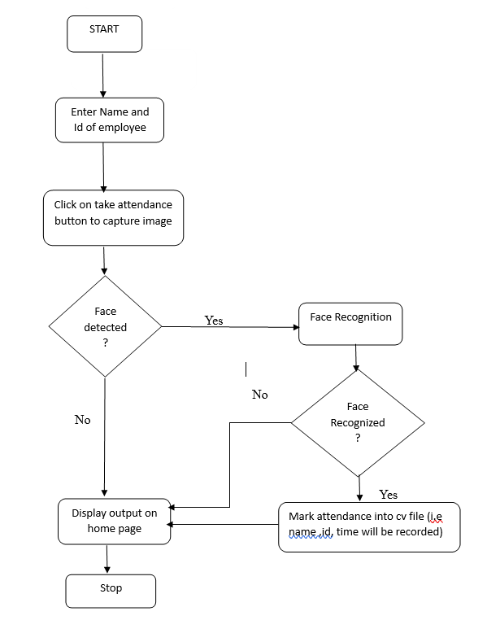
Process Diagram

Slide 9
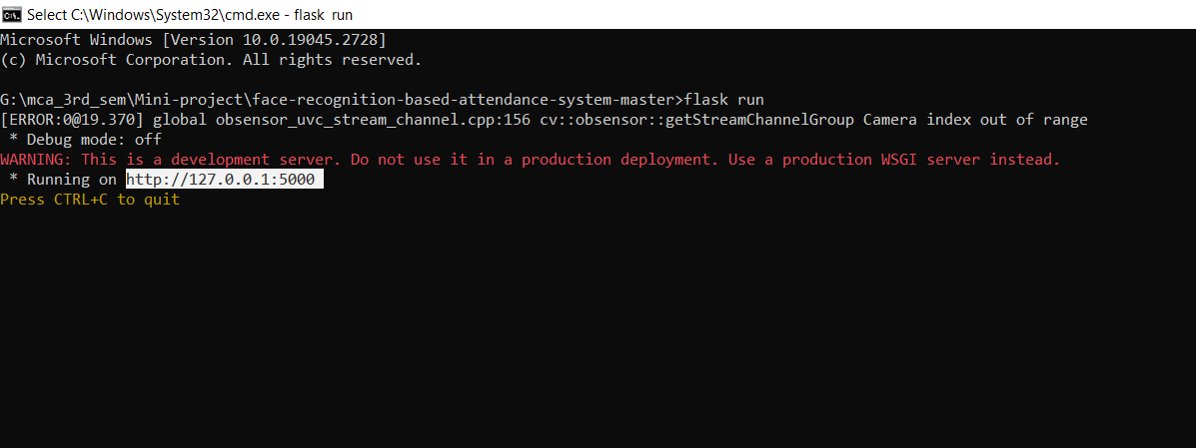
Screen Shots

Slide 10
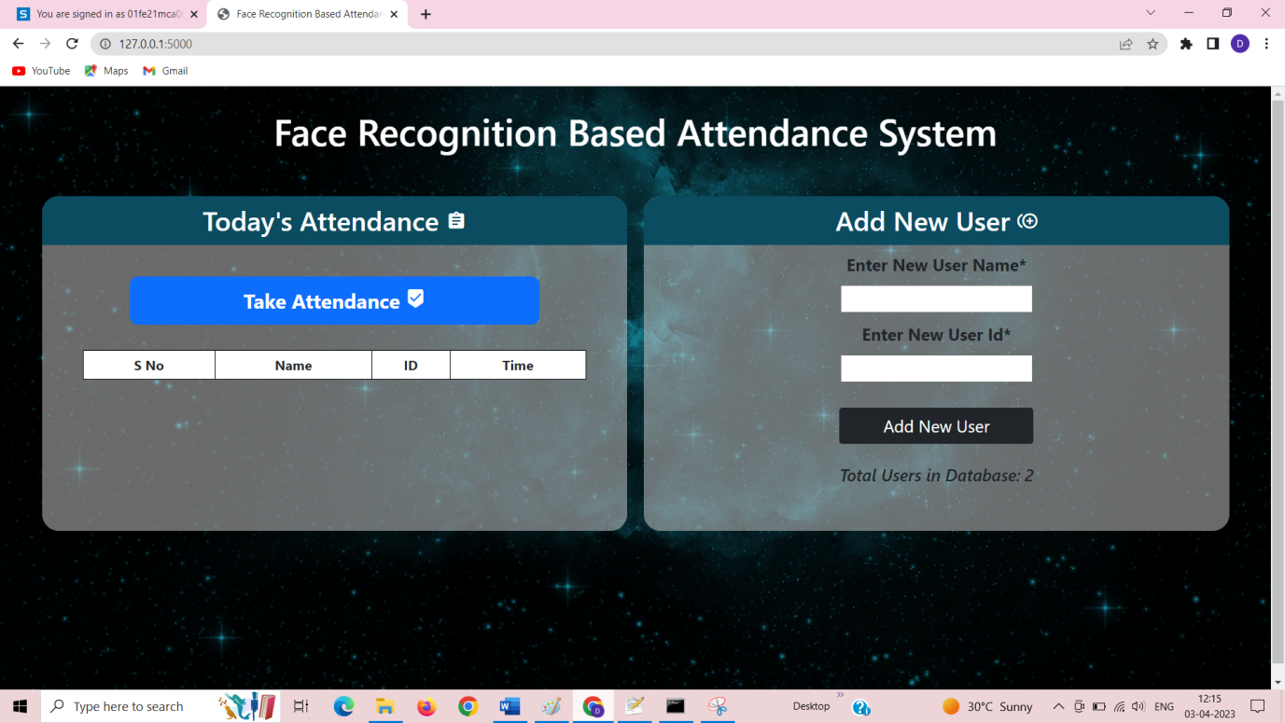
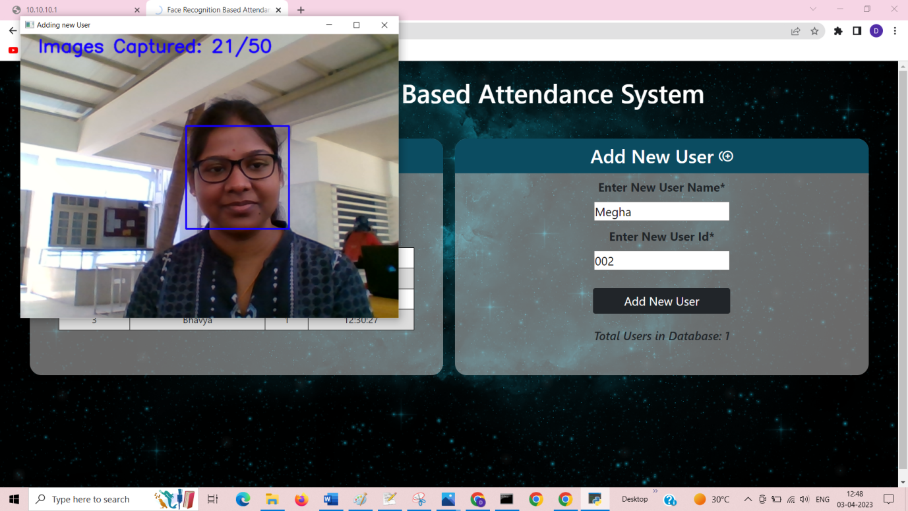

Slide 11
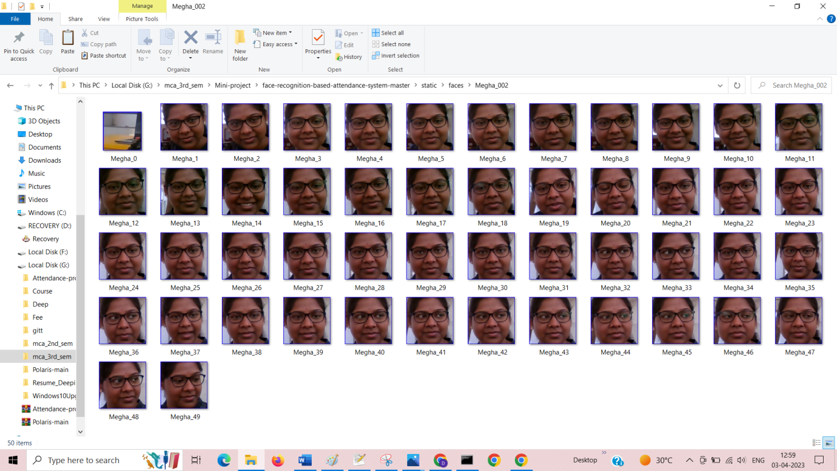
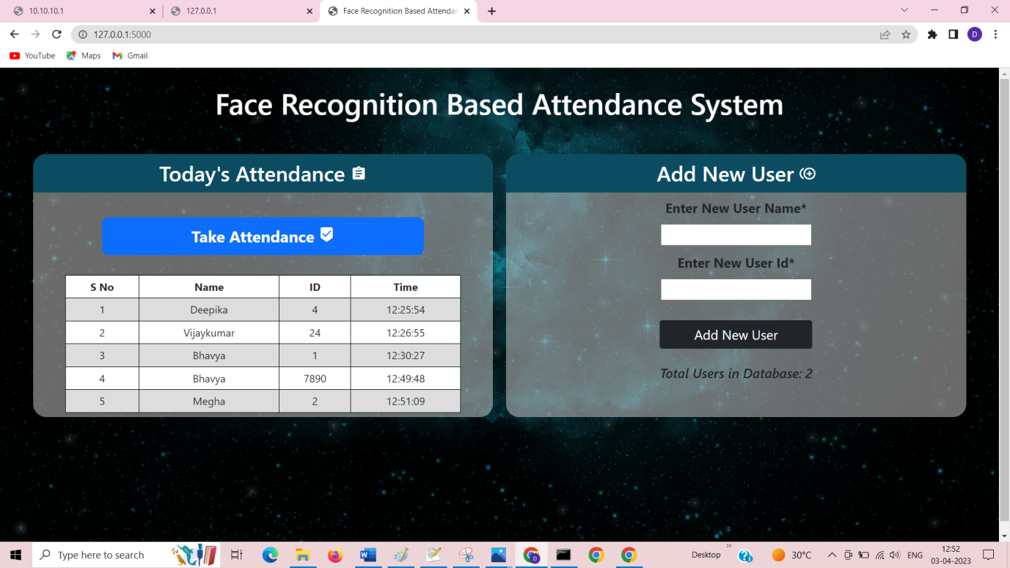

Slide 12
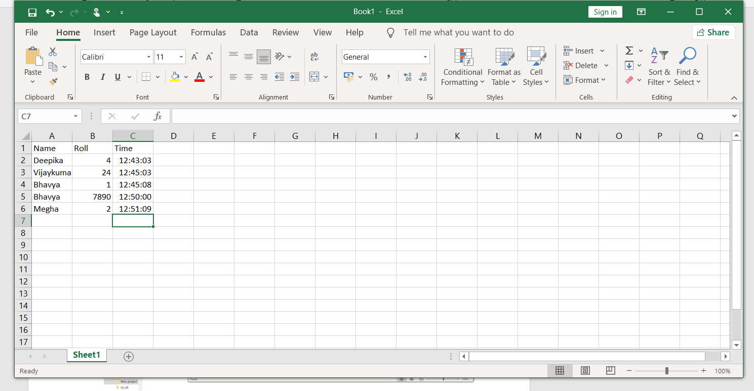

Slide 13
Conclusion
Local Binary Patterns Histograms (LBPH) is a popular and effective method for face recognition and recording the attendances that has been widely used in various applications.
Despite its successes, LBPH still faces challenges, such as sensitivity to illumination and pose variations. To address these challenges and improve its accuracy and performance, future enhancements such as integrating deep learning techniques, incorporating additional modalities, and optimizing the algorithm for mobile devices can be considered.
With ongoing research and technological advancements, LBPH and other face recognition technologies are expected to continue improving, enabling more accurate, reliable, and secure recognition of individuals in various settings.
This solution is both cost-effective and efficient when contrasted to other biometric solutions. The cost and time saved are even larger because the data acquired from the face recognition attendance system is accurate in real-time. Because the overall process is automated, human intervention is limited.

Slide 14
Thank You.

